Slide 1
Photomicrographs of Plant foods
Blueberry
Permission to reproduce original photomicrographs used to make this collection may be obtained from
Dr. David O. Norris at
david.norris@colorado.edu

Slide 2
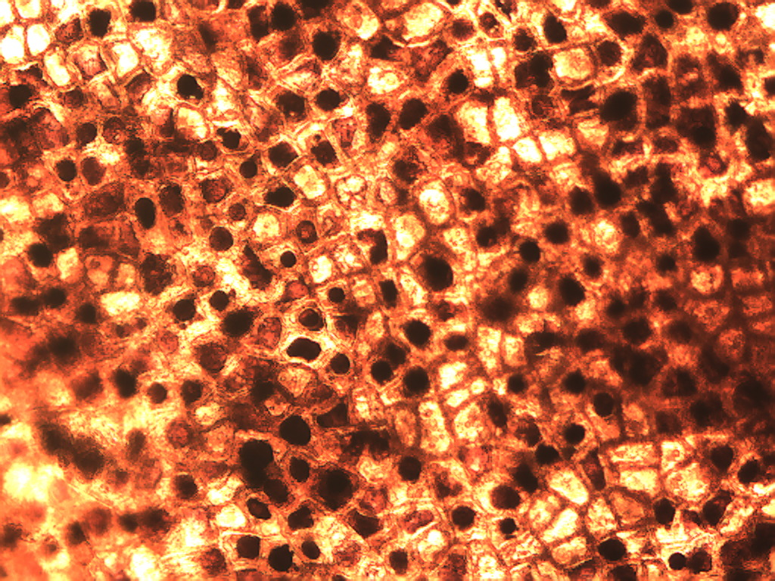
Notes:
92. Vaccinium spp. L. Blueberry. Skin, epidermis, 10X.

Slide 3
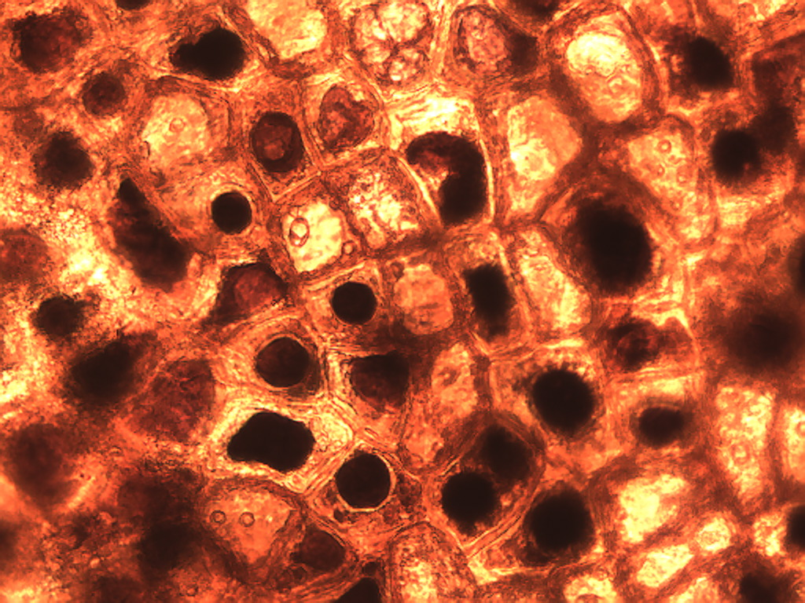
P
Notes:
93. Blueberry. Skin, epidermis, 25X. Intracellular pigment (P).

Slide 4
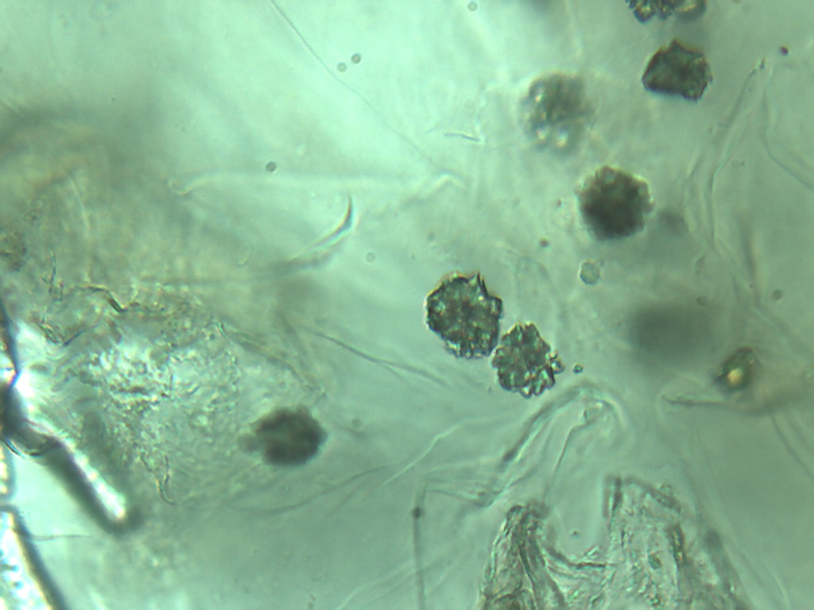
Notes:
94. Blueberry. Druse crystals in pulp region (arrows), 40X.

Slide 5
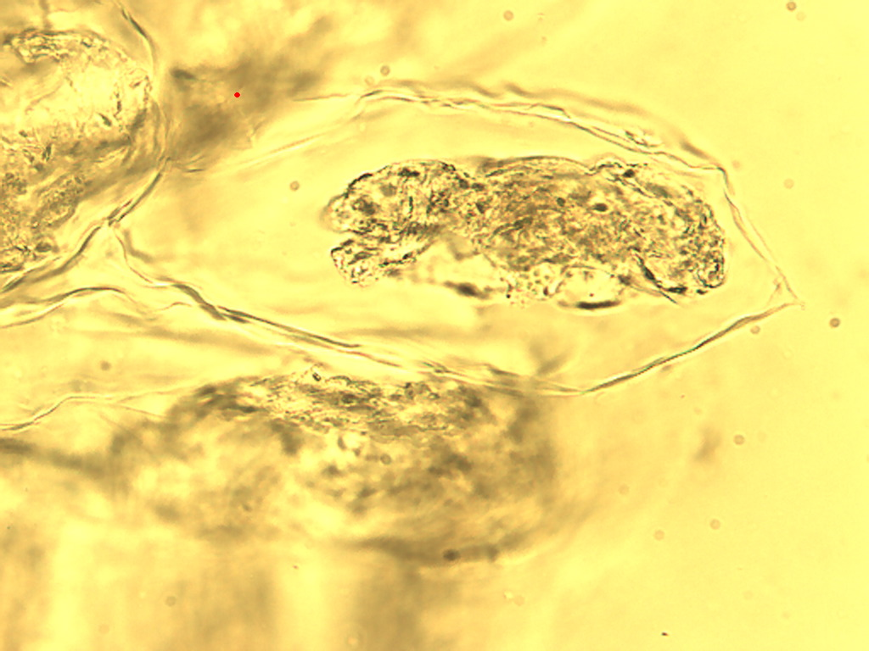
Notes:
95. Blueberry. Pulp parenchymal cell, 25X.

Slide 6
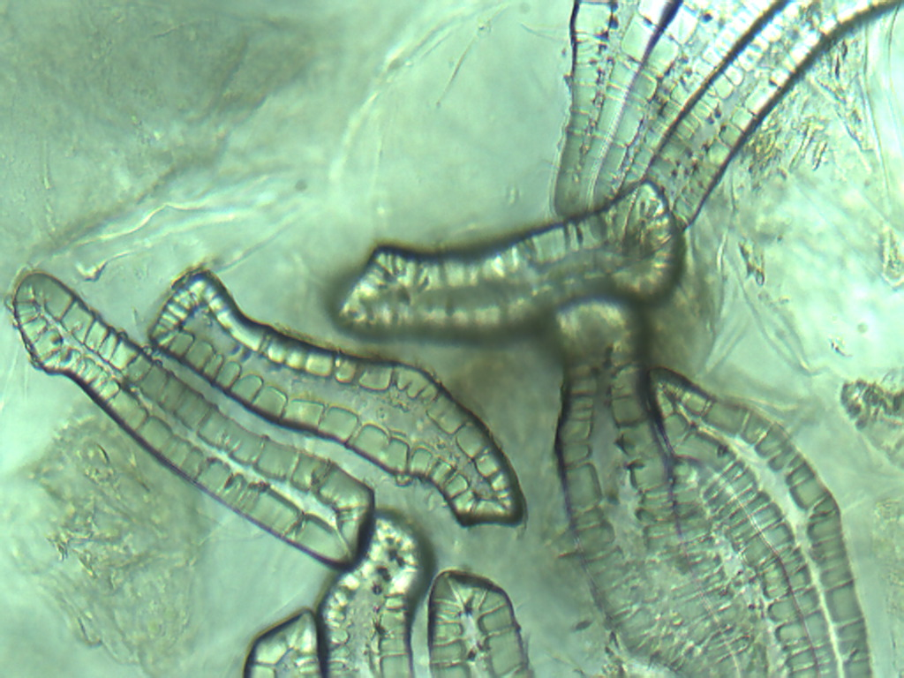
Notes:
96. Blueberry. Sclerids in pulp, 25X.

Slide 7
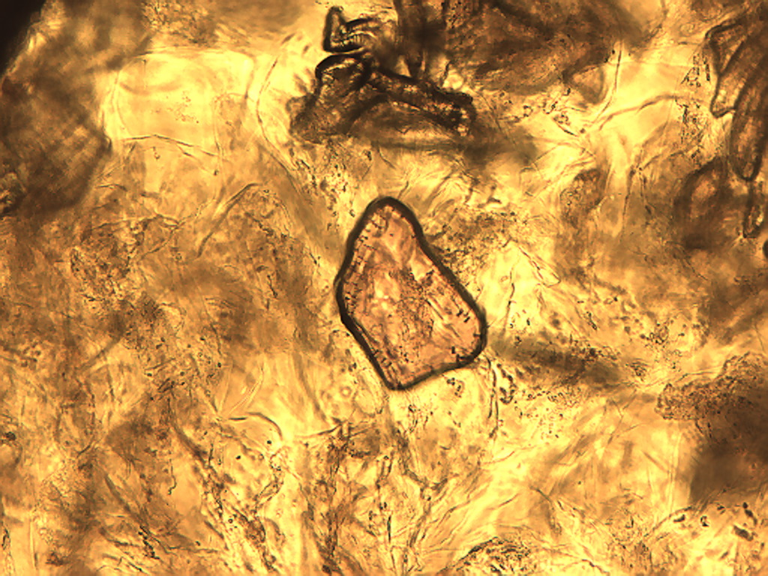
Notes:
97. Blueberry. Multiple irregularly shaped pigmented inclusions (arrows) with thin-walled pulp cells in background, 10X.

Slide 8
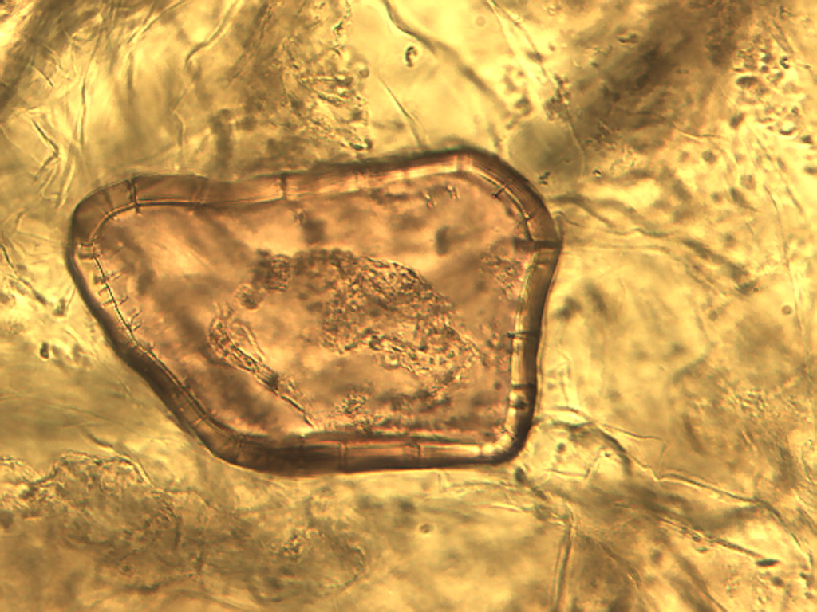
Notes:
98. Blueberry. Irregular pink inclusion observed in various sizes and shapes, 25X.

